Slide 1
Introduction to Statistics for Ecology and Evolutionary Biology Interactions Week 12 22 November 2021

Slide 2
Notes:
Emphasize the unity between many common statistical tests and the procedures we’ve learned in this course (implementing these types of analyses as different forms of regression)
https://lindeloev.github.io/tests-as-linear/

Slide 3
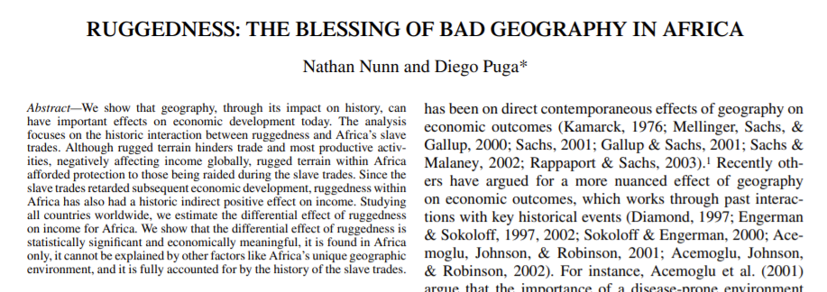
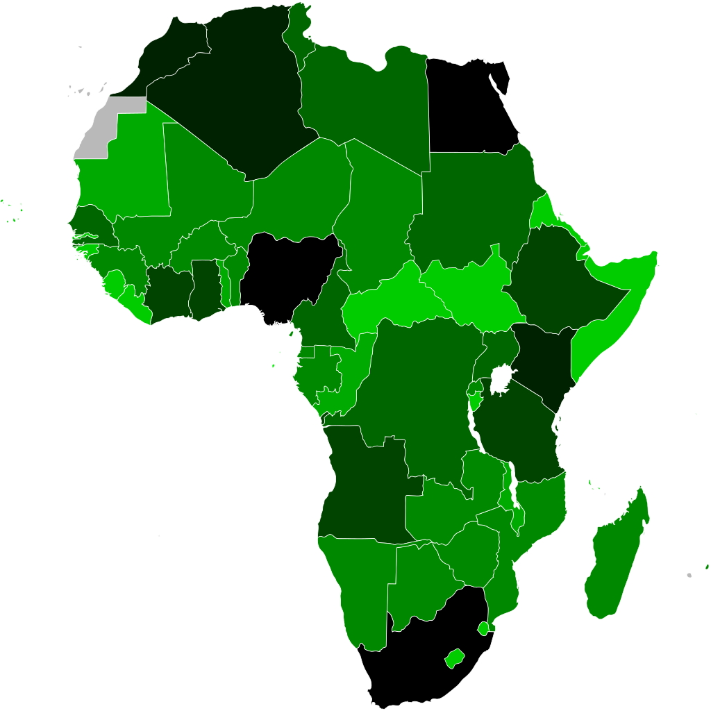
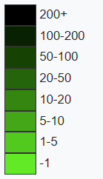
What predicts GDP?
Ruggedness can negatively affect economic development
Ruggedness also protected some countries from slave traders, and salve trade negatively affected subsequent economic development
Notes:
Note that GDP (gross domestic product) is a common economic indicator but also a silly one as it says little about the health of an economy or the distribution of income in the population.

Slide 4
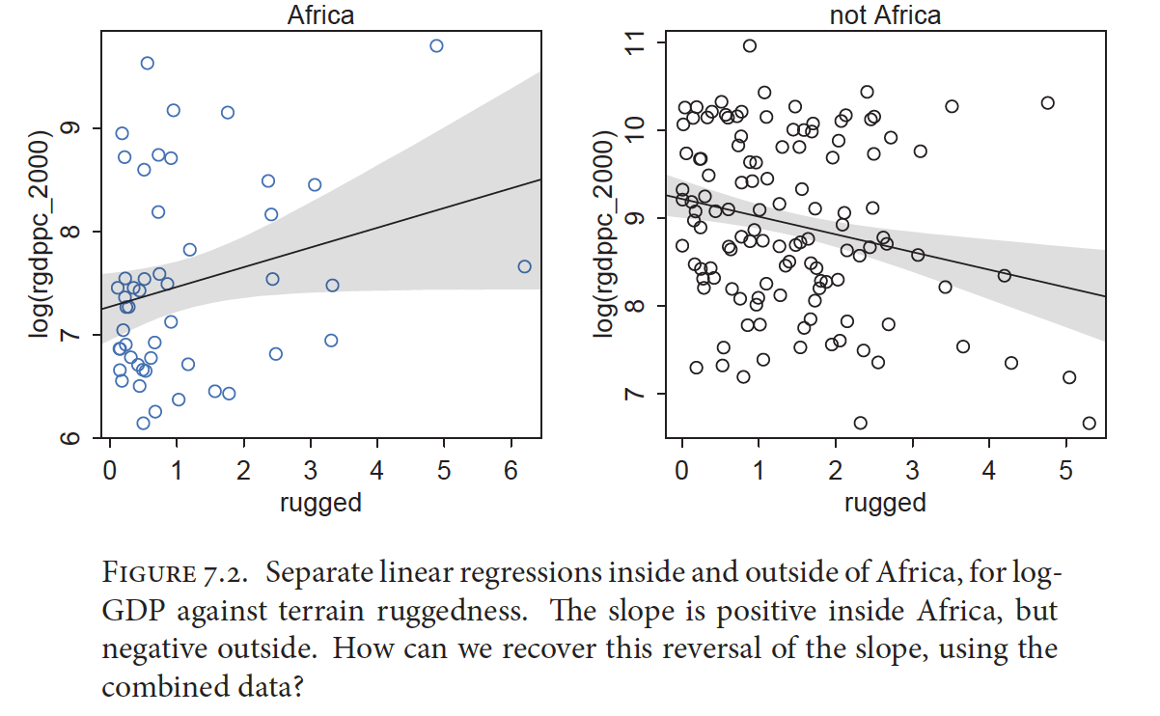
Interactions: What If Predictors Depend Upon Other Predictors?

Slide 5
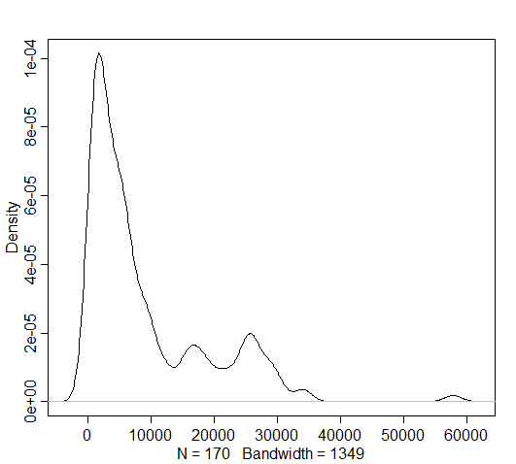
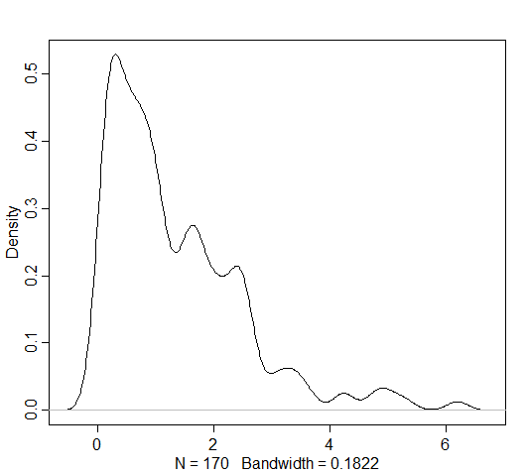
Dataset “rugged”
Rgdppc_2000: Per capita GDP in 2000
Rugged: Magnitude of terrain ruggedness
GDP
ruggedness

Slide 6
Data transformations
Ruggedness:
Value of 0 means flat
Raw values not easily interpreted
Best transformation: Scale to range from 0 – 1 by dividing each value by the maximum
Per capita GDP
Mean is about $9,000 per person
Absolute values aren’t that meaningful
Best transformation: Either standardize so mean is 0 (subtract mean and divide by SD) or scale so values are % of world mean GDP (divide by mean)

Slide 7
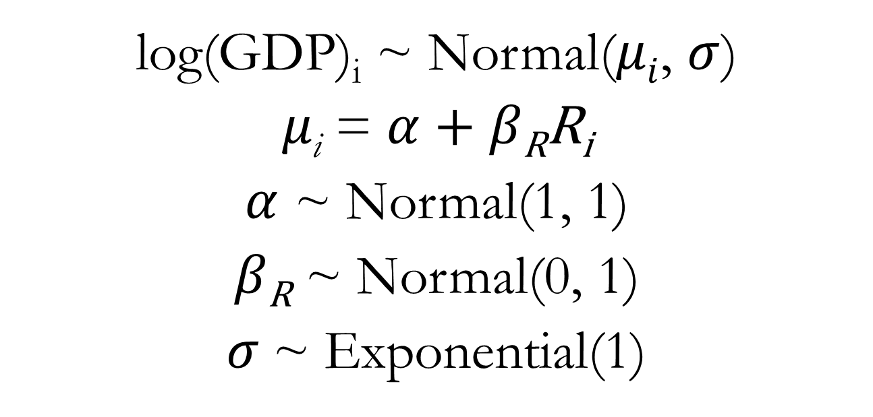
Linear Regression for GDP Predictor: Ruggedness (R)
log(GDP)_{i} ~ Normal($μi$, $σ$)
$μ\text{i}$ = $α$ + $β\text{R}\text{R}\text{i}$
$α$ ~ Normal(1, 1)
$β\text{R}$ ~ Normal(0, 1)
$σ$~ Exponential(1)
See lecture code
Notes:
We use log(GDP) because like other variables we have encountered, GDP tends to increase exponentially with underlying predictors (wealth generates wealth).

Slide 8
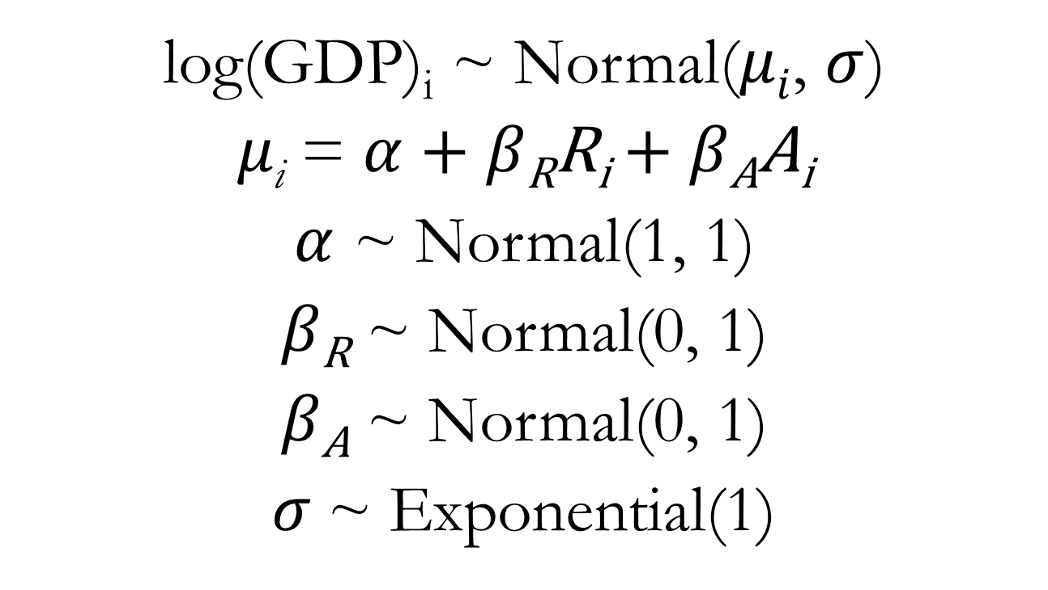
Multiple Regression for GDP Predictors: Ruggedness (R) and Continent Identity (A)
log(GDP)_{i} ~ Normal($μi$, $σ$)
$μ\text{i}$ = $α$ + $β\text{R}\text{R}\text{i}$ + $β\text{A}\text{A}\text{i}$
$α$ ~ Normal(1, 1)
$β\text{R}$ ~ Normal(0, 1)
$β\text{A}$ ~ Normal(0, 1)
$σ$~ Exponential(1)
See lecture code
Notes:
Where Ai is a dummy variable indicating whether or not the country in question is within Africa or not

Slide 9

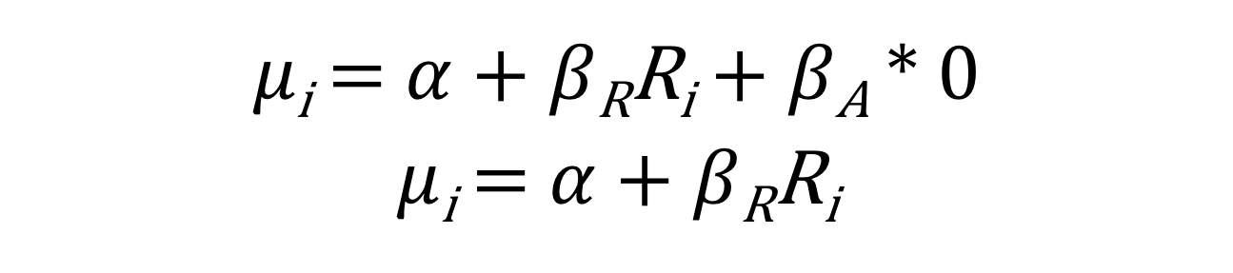
Equation for the Mean GDP
$μ\text{i}$ = $α$ + $β\text{R}\text{R}\text{i}$ + $β\text{A}A\text{i}$
Outside of Africa: A_{i} = 0
$μ\text{i}$ = $α$ + $β\text{R}\text{R}\text{i}$ + $β\text{A}$ * 0
$μ\text{i}$ = $α$ + $β\text{R}\text{R}\text{i}$

Slide 10

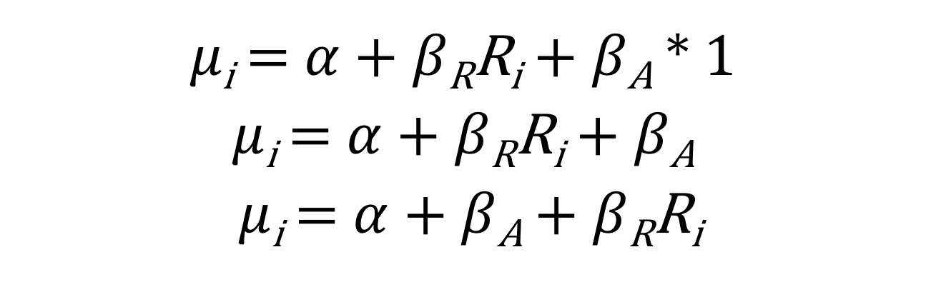
Equation for the Mean GDP
$μ\text{i}$ = $α$ + $β\text{R}\text{R}\text{i}$ + $β\text{A}A\text{i}$
In Africa: A_{i} = 1
$μ\text{i}$ = $α$ + $β\text{R}\text{R}\text{i}$ + $β\text{A}$ * 1
$μ\text{i}$ = $α$ + $β\text{R}\text{R}\text{i}$ + $β\text{A}$
$μ\text{i}$ = $α$ + $β\text{A}$ + $β\text{R}\text{R}\text{i}$

Slide 11
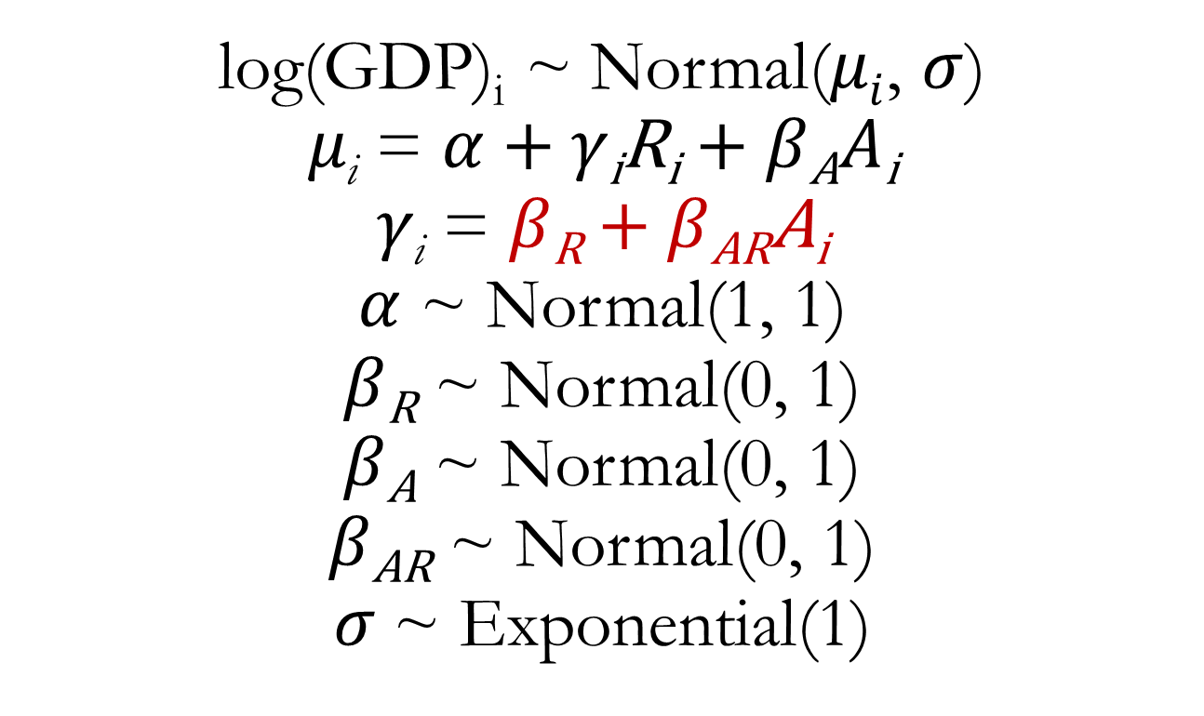
Multiple Regression for GDP Predictors: Ruggedness, Continent Identity, and Interaction
log(GDP)_{i} ~ Normal($μi$, $σ$)
$μ\text{i}$ = $α$ + $γ\text{i}\text{R}\text{i}$ + $β\text{A}A\text{i}$
$γ\text{i}$ = $β\text{R}$ + $β\text{A}\text{R}\text{A}\text{i}$
$α$ ~ Normal(1, 1)
$β\text{R}$ ~ Normal(0, 1)
$β\text{A}$ ~ Normal(0, 1)
$β\text{A}\text{R}$ ~ Normal(0, 1)
$σ$~ Exponential(1)

Slide 12
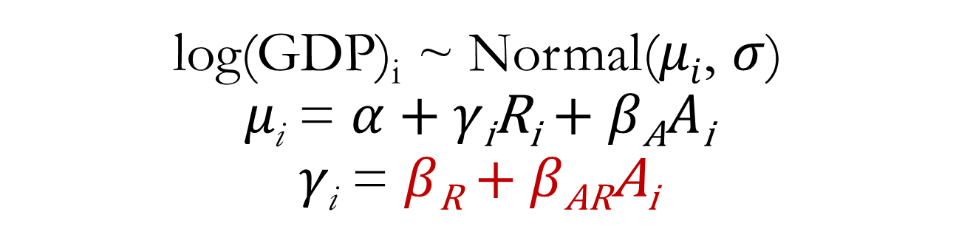
Multiple Regression for GDP Predictors: Ruggedness, Continent Identity, and Interaction
log(GDP)_{i} ~ Normal($μi$, $σ$)
$μ\text{i}$ = $α$ + $γ\text{i}\text{R}\text{i}$ + $β\text{A}A\text{i}$
$γ\text{i}$ = $β\text{R}$ + $β\text{A}\text{R}\text{A}\text{i}$
The slope coefficient, that is, the association between GDP and ruggedness, is itself a linear function with one predictor, A (our index variable for Africa)

Slide 13
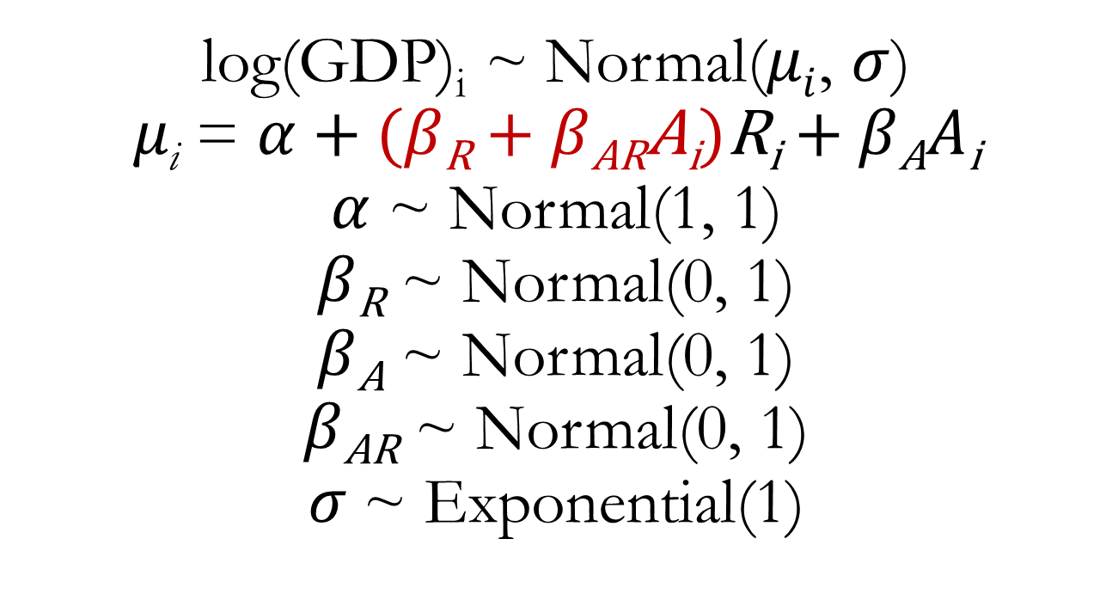
Plug equation for gamma into equation for mean GDP
log(GDP)_{i} ~ Normal($μi$, $σ$)
$μ\text{i}$ = $α$ + ($β\text{R}$ + $β\text{AR}\text{A}\text{i}$)$\text{R}\text{i}$ + $β\text{A}A\text{i}$
$α$ ~ Normal(1, 1)
$β\text{R}$ ~ Normal(0, 1)
$β\text{A}$ ~ Normal(0, 1)
$β\text{A}\text{R}$ ~ Normal(0, 1)
$σ$~ Exponential(1)

Slide 14
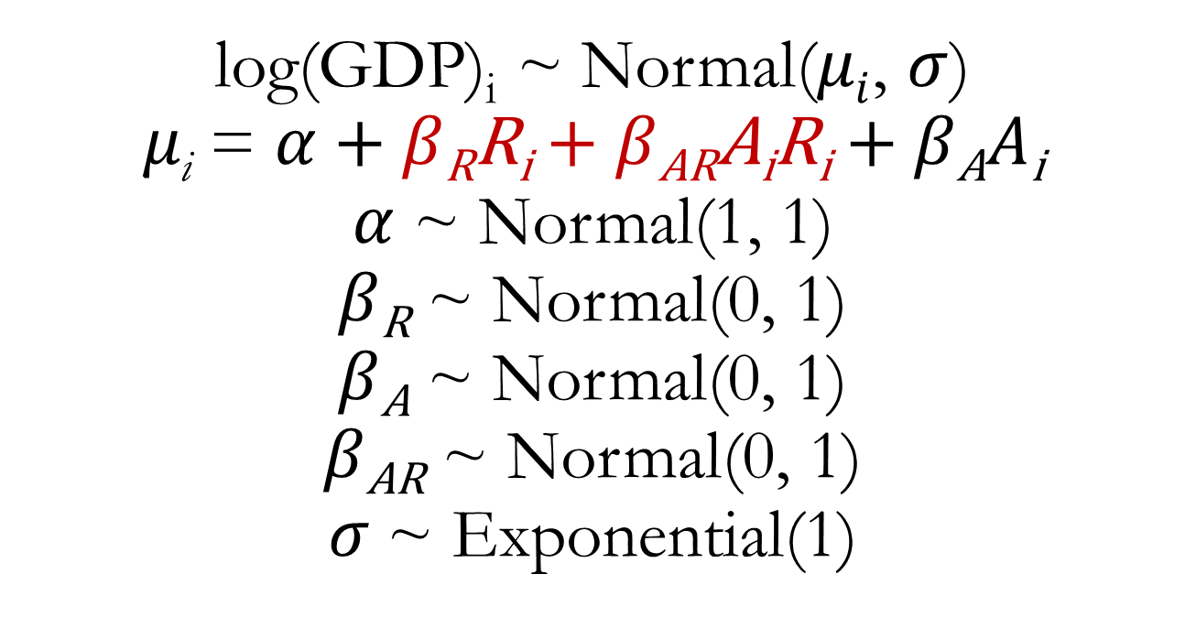
Apply some algebra distributive rule: m(a + b) = ma + mb
log(GDP)_{i} ~ Normal($μi$, $σ$)
$μ\text{i}$ = $α$ + $β\text{R}\text{R}\text{i}$ + $β\text{AR}\text{A}\text{i}\text{R}\text{i}$ + $β\text{A}A\text{i}$
$α$ ~ Normal(1, 1)
$β\text{R}$ ~ Normal(0, 1)
$β\text{A}$ ~ Normal(0, 1)
$β\text{A}\text{R}$ ~ Normal(0, 1)
$σ$~ Exponential(1)

Slide 15
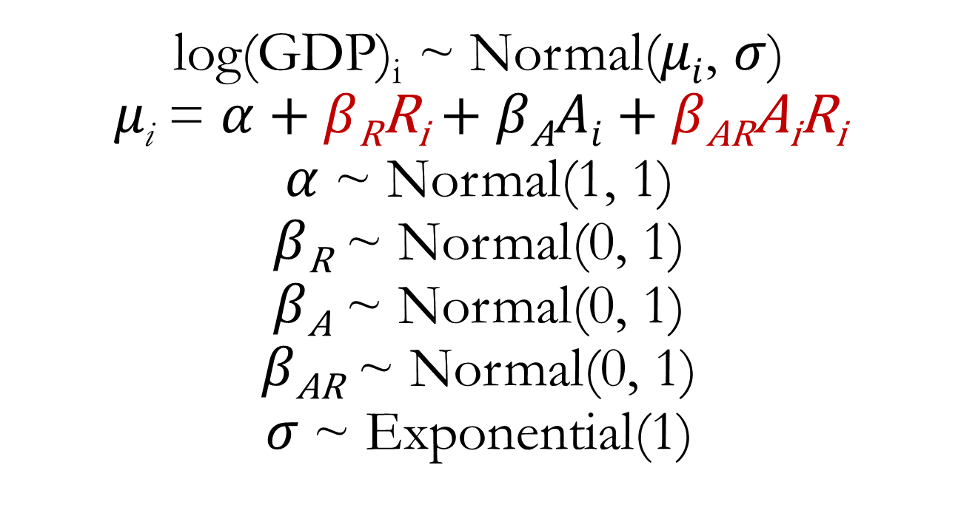
Rearrange
log(GDP)_{i} ~ Normal($μi$, $σ$)
$μ\text{i}$ = $α$ + $β\text{R}\text{R}\text{i}$ + $β\text{A}Ai$ + $β\text{AR}\text{A}\text{i}\text{R}\text{i}$
$α$ ~ Normal(1, 1)
$β\text{R}$ ~ Normal(0, 1)
$β\text{A}$ ~ Normal(0, 1)
$β\text{A}\text{R}$ ~ Normal(0, 1)
$σ$~ Exponential(1)

Slide 16
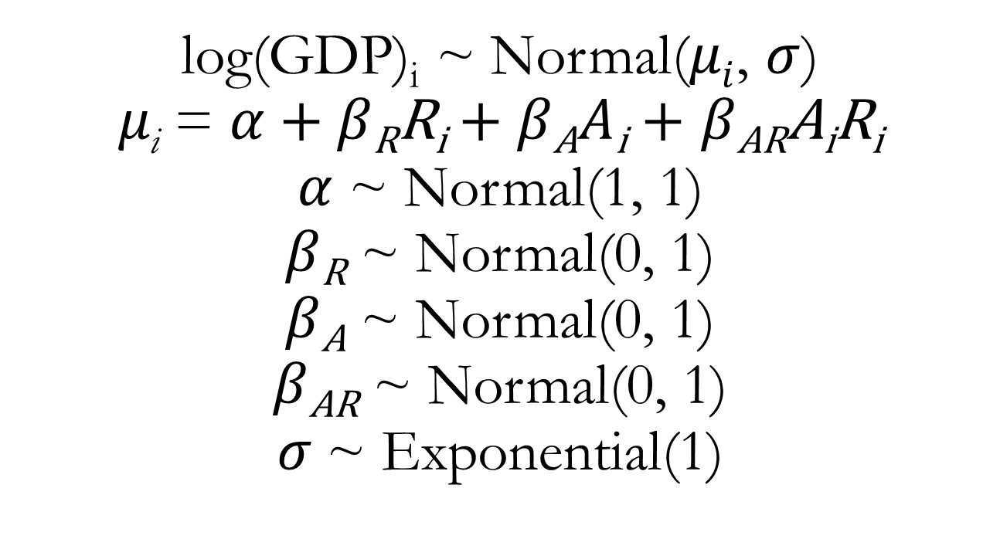
Multiple Regression for GDP Predictors: Ruggedness, Continent Identity, and Interaction
log(GDP)_{i} ~ Normal($μi$, $σ$)
$μ\text{i}$ = $α$ + $β\text{R}\text{R}\text{i}$ + $β\text{A}A\text{i}$ + $β\text{AR}\text{A}\text{i}\text{R}\text{i}$
$α$ ~ Normal(1, 1)
$β\text{R}$ ~ Normal(0, 1)
$β\text{A}$ ~ Normal(0, 1)
$β\text{A}\text{R}$ ~ Normal(0, 1)
$σ$~ Exponential(1)
Dummy variable coding for A

Slide 17
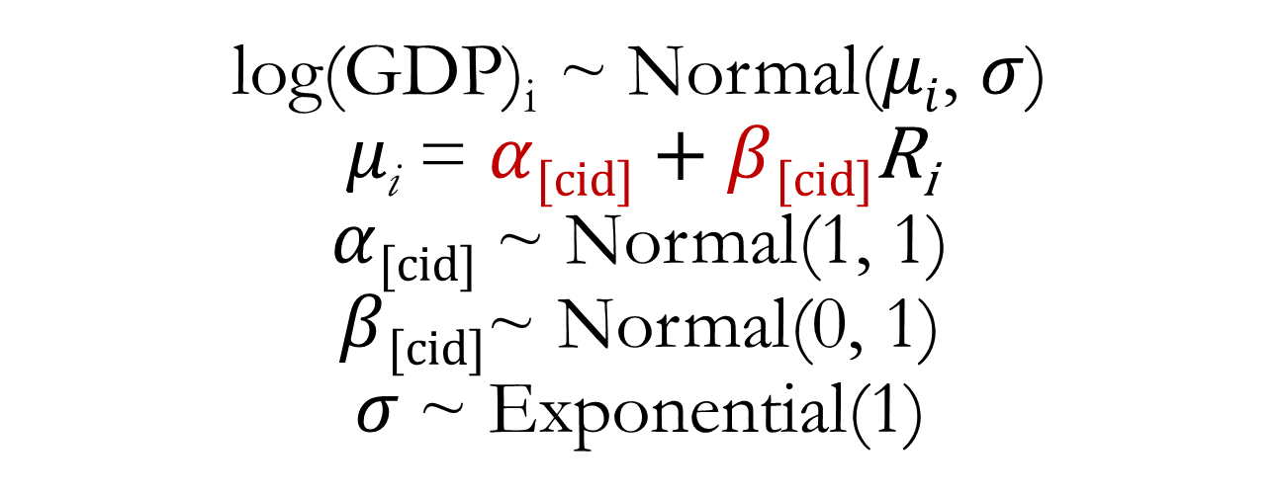
Multiple Regression for GDP Predictors: Ruggedness, Continent Identity, and Interaction
log(GDP)_{i} ~ Normal($μi$, $σ$)
$μ\text{i}$ = $α$_{[cid]} + $β$_{[cid]}$\text{R}\text{i}$
$α$_{[cid]} ~ Normal(1, 1)
$β$_{[cid]}~ Normal(0, 1)
$σ$~ Exponential(1)
Index variable coding for A
Both the intercept and slope are modelled separately for each level of the index variable.
See lecture code

